Slide 1
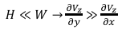
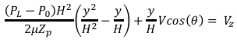
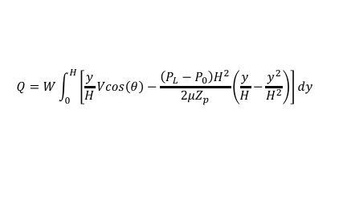
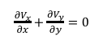
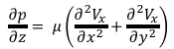
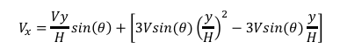
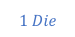
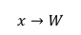
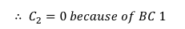
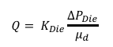
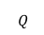
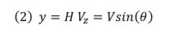
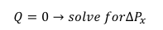
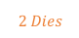
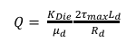
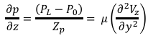
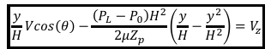
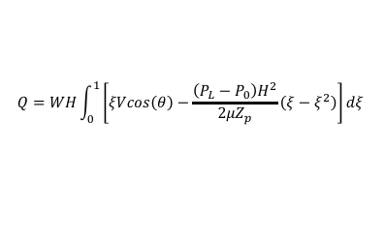
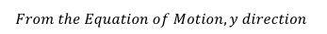
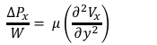
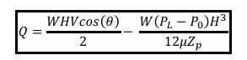
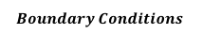
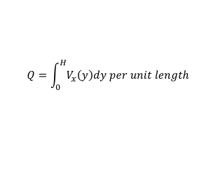
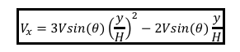
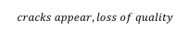
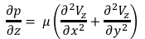
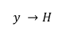
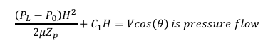
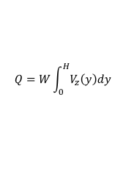
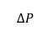
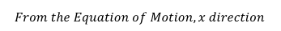
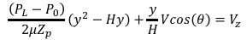
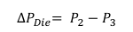
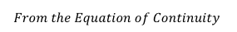
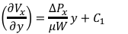
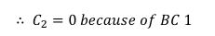
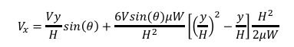
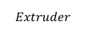
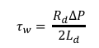
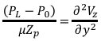
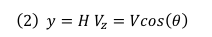
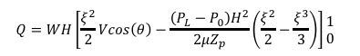
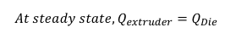
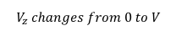
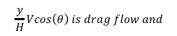
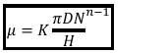
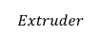
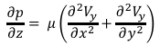
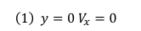
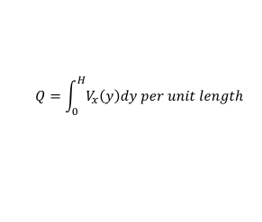





















Emulsification: The dispersion of one phase into the other in the form of fine droplets.
Inertial subrange: The root mean square velocity between 2 points distance l apart is
Deformation leads to smaller radius of
curvature and hence larger pressure
difference.
For breakup of a spherical droplet of radius
R, the pressure gradient dp/dr needed is given by
Droplet Breakup
Microscale of turbulence
p₀
Extrusion:
Apparent Viscosity inside an Extruder
p₁
r
$$V_{z} changes from 0 to V$$
$$From the Equation of Continuity$$
$$x→W$$
$$y →H$$
$$\boxed{μ={K\frac{πDN}{H}}^{n−1}}$$
$\frac{∂V_{x}}{∂x}+$ $\frac{∂V_{y}}{∂y}=0$
Deformed drop
Velocity Profile in the Z Direction
Drop of radius R
r < R
$$\frac{∂p}{∂z}= μ\left(\frac{∂^{2}V_{z}}{∂x^{2}}+\frac{∂^{2}V_{z}}{∂y^{2}}\right)$$
Flow Rate, Q_{D}, within the Die
$$From the Equation of Motion, y direction$$
Laminar flow- causes shear or elongation of the droplet Turbulent flow- causes random deformation of the droplet due to pressure fluctuation Cavitation- collapse of small vapor bubbles cause shock waves causing intense agitation
$$Q= K_{Die}\frac{{∆P}_{Die}}{μ_{d}}$$
$$\frac{∂p}{∂z}= μ\left(\frac{∂^{2}V_{y}}{∂x^{2}}+\frac{∂^{2}V_{y}}{∂y^{2}}\right)$$
$H≪W→$ $\frac{∂V_{z}}{∂y}≫$ $\frac{∂V_{z}}{∂x}$
$$\frac{∂p}{∂z}= μ\left(\frac{∂^{2}V_{y}}{∂y^{2}}\right)→\frac{∂p}{∂z}=0$$
Lubrication
Approximation
$$\frac{∂p}{∂z}=\frac{\left(P_{L}−P_{0}\right)}{Z_{p}}= μ\left(\frac{∂^{2}V_{z}}{∂y^{2}}\right)$$
$${∆P}_{Die}= P_{2}−P_{3}$$
$$From the Equation of Motion, x direction$$
Emulsion capacity- Maximum amount of dispersed phase (oil or water) that can be emulsified ( measure of surfactant to form emulsion) Emulsion stability heat stability: stability for brownian flocculation centrifugal stability: stability for creaming measure of surfactant to provide shelf life to emulsion Drop size turbidity: surface area per unit volume drop size distribution
$$\frac{\left(P_{L}−P_{0}\right)}{{μZ}_{p}}=\frac{∂^{2}V_{z}}{∂y^{2}}$$
$$P_{3}=P_{atm}=P_{1} ∴$$
$$\frac{∂p}{∂z}= μ\left(\frac{∂^{2}V_{x}}{∂x^{2}}+\frac{∂^{2}V_{x}}{∂y^{2}}\right)$$
$${∆P}_{Die}= P_{2}−P_{1}$$
$$\frac{{∆P}_{x}}{W}= μ\left(\frac{∂^{2}V_{x}}{∂y^{2}}\right)$$
$$\frac{\left(P_{L}−P_{0}\right)y}{{μZ}_{p}}+C_{1}=\frac{∂V_{z}}{∂y}$$
$$At steady state, Q_{extruder}=Q_{Die}$$
$$\frac{\left(P_{L}−P_{0}\right)y^{2}}{{μZ}_{p}}+C_{1}y+ C_{2}=V_{z}$$
$$Die$$
$$\left(\frac{∂V_{x}}{∂y}\right)=\frac{{∆P}_{x}}{μW}y+C_{1}$$
$$Q$$
$$Extruder$$
$$V_{x}=\frac{{∆P}_{x}y^{2}}{2μW}+C_{1}y+C_{2}$$
$$Boundary Conditions$$
$$\left(1\right) y=0 V_{z}=0$$
$$∆P$$
$$Boundary Conditions$$
$$\left(2\right) y=H V_{z}=Vcos\left(θ\right)$$
$$\left(1\right) y=0 V_{x}=0$$
Colloid Mill
$$\left(2\right) y=H V_{z}=Vsin\left(θ\right)$$
$$C_{1}=\frac{1}{H}Vsin\left(θ\right)−\frac{{∆P}_{x}H}{2μW}$$
$$∴ C_{2}=0 because of BC 1$$
$$∴ C_{2}=0 because of BC 1$$
$$C_{1}=\frac{1}{H}Vcos\left(θ\right)−\frac{\left(P_{L}−P_{0}\right)H}{2{μZ}_{p}}$$
$$\boxed{V_{x}=\frac{{∆P}_{x}y^{2}}{2μW}+\left[\frac{1}{H}Vsin\left(θ\right)−\frac{{∆P}_{x}H}{2μW}\right]y}$$
$$\frac{\left(P_{L}−P_{0}\right)y^{2}}{{μZ}_{p}}+\left[\frac{1}{H}Vcos\left(θ\right)−\frac{\left(P_{L}−P_{0}\right)H}{2{μZ}_{p}}\right]y=V_{z}$$
$$Q=\int_{0}^{H}{V_{x}\left(y\right)dy per unit length}$$
Example: Vegetable oil ( of viscosity 1cp) is to be emulsified in water (with
emulsifiers and proteins) using a colloid mill. D = 0.1 m. h = 100 ,
N = 60,000 rpm. = 20 mN/m. Calculate the mean drop size of the emulsion.
Solution:
$$\frac{\left(P_{L}−P_{0}\right)}{2{μZ}_{p}}\left(y^{2}−Hy\right)+\frac{y}{H}Vcos\left(θ\right)=V_{z}$$
$$Q=0→solve for{∆P}_{x}$$
$$Q=\int_{0}^{H}{V_{x}\left(y\right)dy per unit length}$$
$$\frac{\left(P_{L}−P_{0}\right)H^{2}}{2{μZ}_{p}}\left(\frac{y^{2}}{H^{2}}−\frac{y}{H}\right)+\frac{y}{H}Vcos\left(θ\right){= V}_{z}$$
$$Q=\frac{HVsin\left(θ\right)}{2}− \frac{{∆P}_{x}H^{3}}{12μW}=0→$$
$${∆P}_{x}= \frac{6Vsin(θ)μW}{H^{2}}0$$
$$\boxed{\frac{y}{H}Vcos\left(θ\right)−\frac{\left(P_{L}−P_{0}\right)H^{2}}{2{μZ}_{p}}\left(\frac{y}{H}−\frac{y^{2}}{H^{2}}\right)=V_{z}}$$
$$V_{x}=\frac{Vy}{H}sin\left(θ\right)+\frac{6Vsin(θ)μW}{H^{2}}\left[{\left(\frac{y}{H}\right)}^{2}−\frac{y}{H}\right]\frac{H^{2}}{2μW}$$
$$where$$
$$\frac{y}{H}Vcos\left(θ\right) is drag flow and$$
$$\frac{\left(P_{L}−P_{0}\right)H^{2}}{2{μZ}_{p}}+C_{1}H=Vcos\left(θ\right) is pressure flow$$
$$V_{x}=\frac{Vy}{H}sin\left(θ\right)+\left[3Vsin(θ){\left(\frac{y}{H}\right)}^{2}−3Vsin(θ)\frac{y}{H}\right]$$
Flow Rate, Q, inside the Extruder
$$\boxed{V_{x}=3Vsin(θ){\left(\frac{y}{H}\right)}^{2}−2Vsin(θ)\frac{y}{H}}$$
$$Q=W\int_{0}^{H}{V_{z}\left(y\right)dy}$$
Turbulent Flow
$$2 Dies$$
average velocity for turbulent flow is characterized by root-mean-square average defined as
$$Q=W\int_{0}^{H}{\left[\frac{y}{H}Vcos\left(θ\right)−\frac{\left(P_{L}−P_{0}\right)H^{2}}{2{μZ}_{p}}\left(\frac{y}{H}−\frac{y^{2}}{H^{2}}\right)\right]dy}$$
$$1 Die$$
$$τ_{w}= \frac{R_{d}∆P}{2L_{d}}$$
Even though the flow is not usually isotropic, for sufficiently large Reynolds numbers, the flow over smaller length scales is locally isotropic
Inertial subrange- range of eddy sizes for which the flow is locally isotropic and viscous dissipation is not important
Viscous subrange- range of eddy sizes for which the flow is locally isotropic and viscous dissipation is important
$$Q$$
$$Extruder$$
$$τ_{w}>τ_{max}$$
$$cracks appear, loss of quality$$
$$Q=WH\int_{0}^{1}{\left[ξVcos\left(θ\right)−\frac{\left(P_{L}−P_{0}\right)H^{2}}{2{μZ}_{p}}\left(ξ−ξ^{2}\right)\right]dξ}$$
$$Q=WH\left[\frac{ξ^{2}}{2}Vcos\left(θ\right)−\frac{\left(P_{L}−P_{0}\right)H^{2}}{2{μZ}_{p}}\left(\frac{ξ^{2}}{2}−\frac{ξ^{3}}{3}\right)\right]\begin{matrix}1 \\ 0\end{matrix}$$
$$∆P$$
$$∆P_{max}= \frac{2τ_{max}L_{d}}{R_{d}}$$
$Q= \frac{K_{Die}}{μ_{d}}$ $\frac{2τ_{max}L_{d}}{R_{d}}$
$$Q=WH\left[\frac{Vcos\left(θ\right)}{2}− \frac{\left(P_{L}−P_{0}\right)H^{2}}{2{μZ}_{p}}\left(\frac{1}{2}−\frac{1}{3}\right)\right]$$
Homogenizer: For a high pressure homogenizer
$$\boxed{Q=\frac{WHVcos\left(θ\right)}{2}− \frac{W\left(P_{L}−P_{0}\right)H^{3}}{12{μZ}_{p}}}$$
Drag Flow Pressure Flow

Slide 2































Thermal Deactivation of bacteria is viewed as a simple first order reaction. .
Aseptic Processing can be achieved through sending a fluid through a tube.
$$\frac{dN}{dt}=−k\left(T\right)N$$
Residence Time
$$\frac{N_{0}}{N}= {10}^{\frac{−θ}{D_{T_{0}}}}$$
$$N{=N}_{0}e^{−k\left(T\right)t}$$
It is tempting to use the average residence time in the above equation to calculate the lethality. It is to be noted that this is incorrect. FDA requires calculation of lethality based on the fastest moving fluid. Since the velocity of the fluid is maximum at the center of the tube, one has to calculate lethality for the fluid at the center of the tube.
$$k(T){=k}_{0}e^{−E/RT}$$
$$k\left(T\right)t=ln\left(\frac{N_{0}}{N}\right)= \frac{1}{2.303}log⁡\left(\frac{N_{0}}{N}\right)$$
$$k\left(T\right)D_{T}=\frac{1}{2.303}\log\left(10\right)=\frac{1}{2.303}$$
$$D_{T}=\frac{1}{2.303k(T)}$$
$$θ= \frac{L}{V_{max}}=\frac{L}{2\overline{V}}$$
$$→\frac{N_{0}}{N}= {10}^{\frac{−1}{D_{T_{0}}}\frac{L}{2\overline{V}}}$$
$$t=D_{T}log⁡\left(\frac{N_{0}}{N}\right)$$
$$D_{T}= {D_{T_{0}}10}^{\frac{−\left(T−T_{0}\right)}{z}}$$
$$\log\left(\frac{N_{0}}{N}\right)=F= {\frac{1}{D_{T_{0}}}{D_{T_{0}}10}^{\frac{\left(T−T_{0}\right)}{z}}}^{}$$
Extent of Over Processing
$$V\left(r\right)=\overline{V}\left(\frac{3n+1}{n+1}\right)\left[1−{\left(\frac{r}{R}\right)}^{\frac{n+1}{n}}\right]$$
$$V\left(y\right)=A\overline{V}\left[1−y^{B}\right]$$
$$y= \frac{r}{R} A=\left(\frac{3n+1}{n+1}\right) B=\frac{n+1}{n}$$
$$residence time of liquid through a cross section$$
$$\frac{L}{V\left(r\right)}=\frac{L}{\overline{V}\left[1−y^{B}\right]}$$
$$\log\left(\frac{D_{T}}{D_{T_{0}}}\right)=−\frac{\left(T−T_{0}\right)}{z}$$
$$The number of viable microorganisms entering the tube$$
$$D_{T}= {D_{T_{0}}10}^{\frac{−\left(T−T_{0}\right)}{z}}$$
$$N_{0}= n_{0}\int_{0}^{R}{2πrV\left(r\right)dr=n_{0}πR^{2}\overline{V}}$$
$$t=D_{T}\log\left(\frac{N_{0}}{N}\right)= {D_{T_{0}}\log\left(\frac{N_{0}}{N}\right)10}^{\frac{−\left(T−T_{0}\right)}{z}}$$
$$The number of viable microorganisms leaving cross section$$
$$F_{0}=D_{T_{0}}\log\left(\frac{N_{0}}{N}\right)={12D}_{T_{0}}$$
$$n_{0}V(r){10}^{−\frac{−L}{\overline{V}\left[1−y^{B}\right]D_{T}}}2πrdr$$
$$N=\int_{0}^{R}{n_{0}V(r){10}^{\frac{−L}{\overline{\overline{V}}\left[1−y^{B}\right]D_{T}}}2πrdr}$$
$$N=\int_{0}^{1}{n_{0}A(1−y^{B})\overline{V}{10}^{\frac{−L}{\overline{A\overline{V}}\left[1−y^{B}\right]D_{T}}}2πR^{2}ydy}$$
$$\frac{N_{0}}{N}=\frac{n_{0}πR^{2}\overline{V}}{\int_{0}^{1}{n_{0}A(1−y^{B})\overline{V}{10}^{\frac{−L}{\overline{A\overline{V}}\left[1−y^{B}\right]D_{T}}}2πR^{2}ydy}}$$
$$\log\left(\frac{N_{0}}{N}\right)=−log\left[\int_{0}^{1}{2n_{0}A(1−y^{B}){10}^{\frac{−L}{\overline{A\overline{V}}\left[1−y^{B}\right]D_{T}}}}ydy\right]$$
Freezing
$${substituting S}_{v}= \frac{L}{\overline{V}D_{T}}$$
$$t_{f}= \frac{λp}{\left(T_{f}−T_{1}\right)}\left[\frac{pa}{h}+\frac{pa^{2}}{k}\right]$$
$$\log\left(\frac{N_{0}}{N}\right)=−log\left[\int_{0}^{1}{2n_{0}A(1−y^{B}){10}^{\frac{−S_{v}}{A\left[1−y^{B}\right]}}ydy}\right]$$
$$p=\frac{1}{6}sphere$$
R$=\frac{1}{24}sphere$
$$p=\frac{1}{4} infinite cylinder$$
R$=\frac{1}{16} infinite cylinder$

